Slide 1
NEXT WORD PREDICTION USING BI-LSTMS
MINI PROJECT - 1
ABHEET KUMAR (19BCS002)
SHIVAM KUMAR SANGAL (19BCS073)
ABHINAV MAURYA (19BCS003)

Slide 2
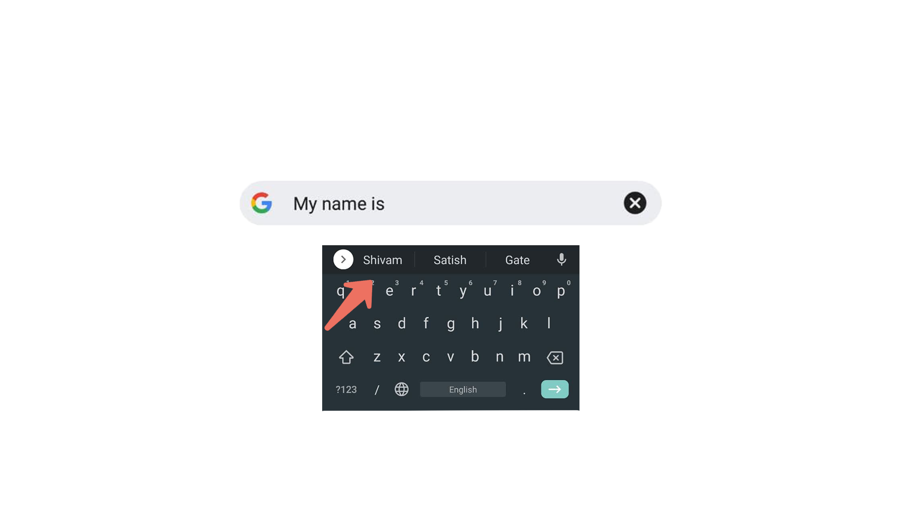
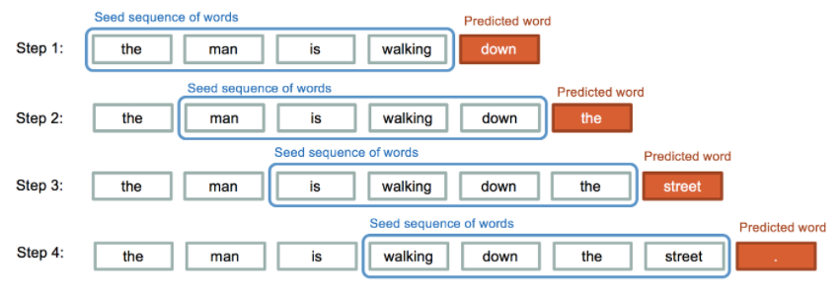
INTRODUCTION
In this Next word prediction project , we try to predict the next character or word of sequence.
We use deep learning models ( BI-LSTM ) for this project. The model will also learn how much similarity is between each word

Slide 3
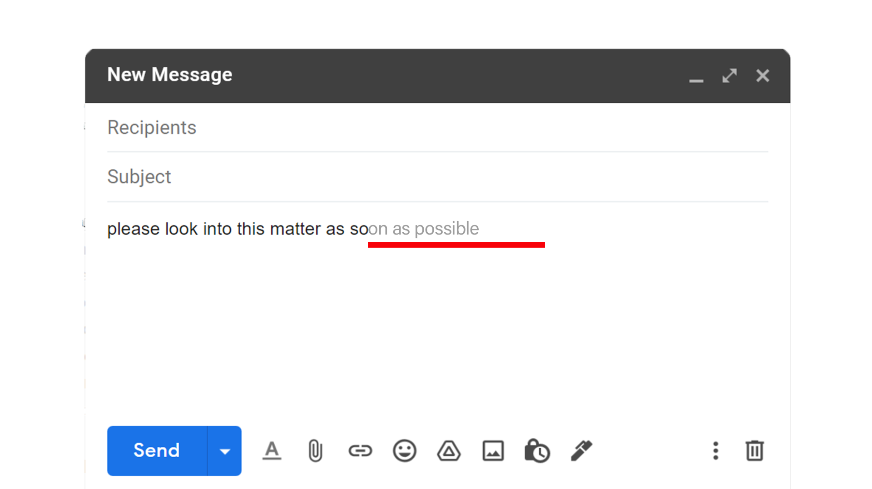
OBJECTIVES
The prime objective of this project is to minimize keystrokes which saves time while typing.

Slide 4

Students who are still working on their language skills can take its help.​​
We can make a system that can generates its own story from scratch by the help of this project

Slide 5
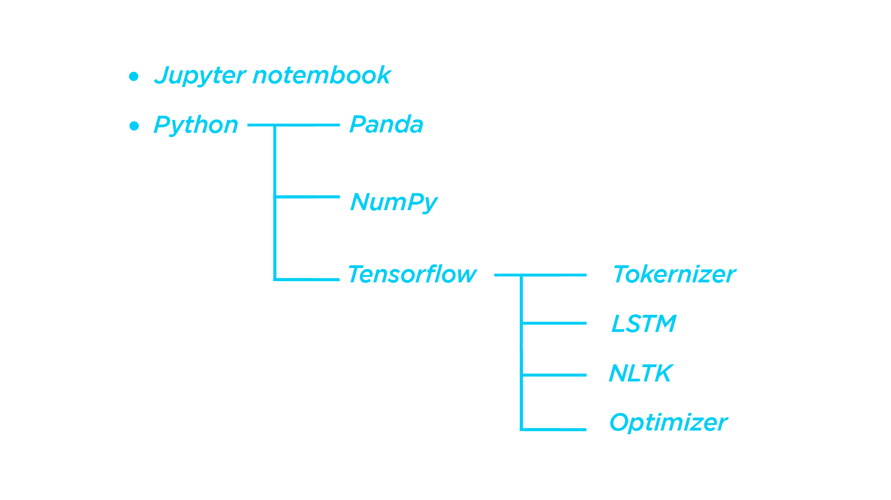
Tools a & Libraries used

Slide 6
Backend

Slide 7
LSTM (Long Short Term Memory) :
We use LSTM because the text generation we have to memorize is a large amount of previous data. LSTM used as solutions for short-term memory learning.
LSTM contains a gate which determines the flow of information.
The gates decide which data is important and can be useful in the future and which data has to be erased. The three gates are the input gate, output gate, and forget gate.

Slide 8
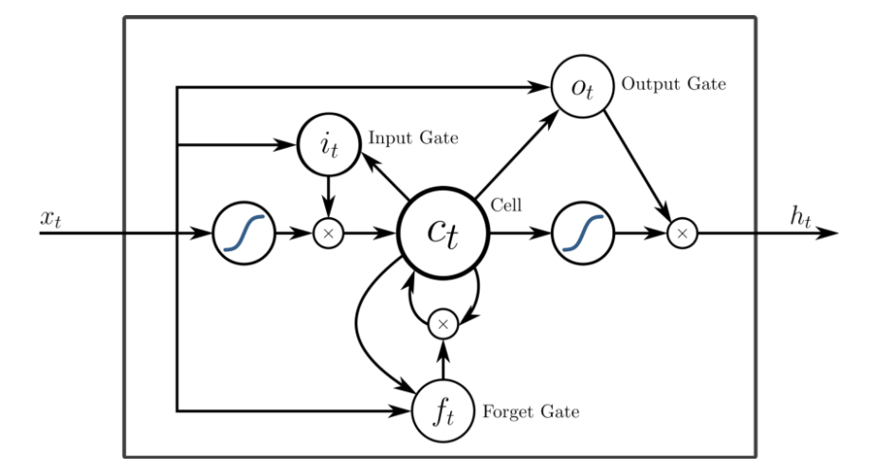

Slide 9
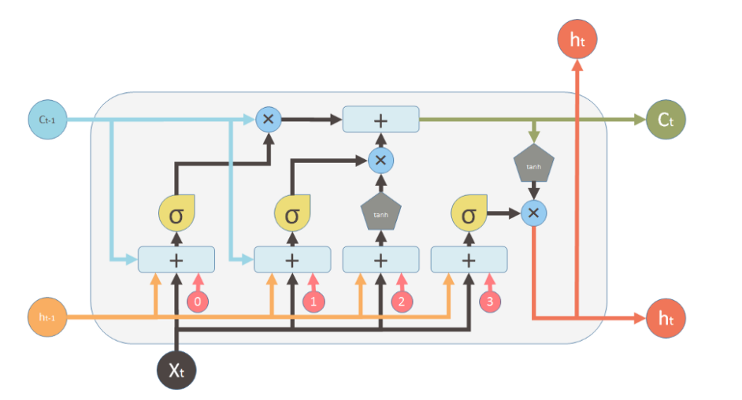
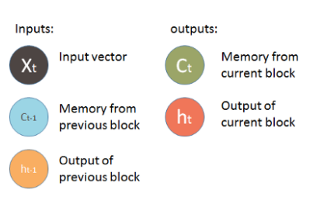
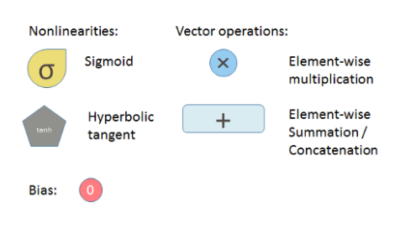

Slide 10
WORKFLOW
Load the text data.
Preprocessing.
Tokenization.
Prepare dataset as input and output sets using dictionary.
Define our model and Training the Model.
Predicting the Result using our Model.

Slide 11
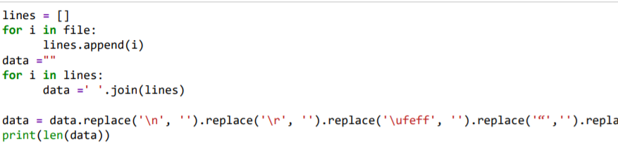
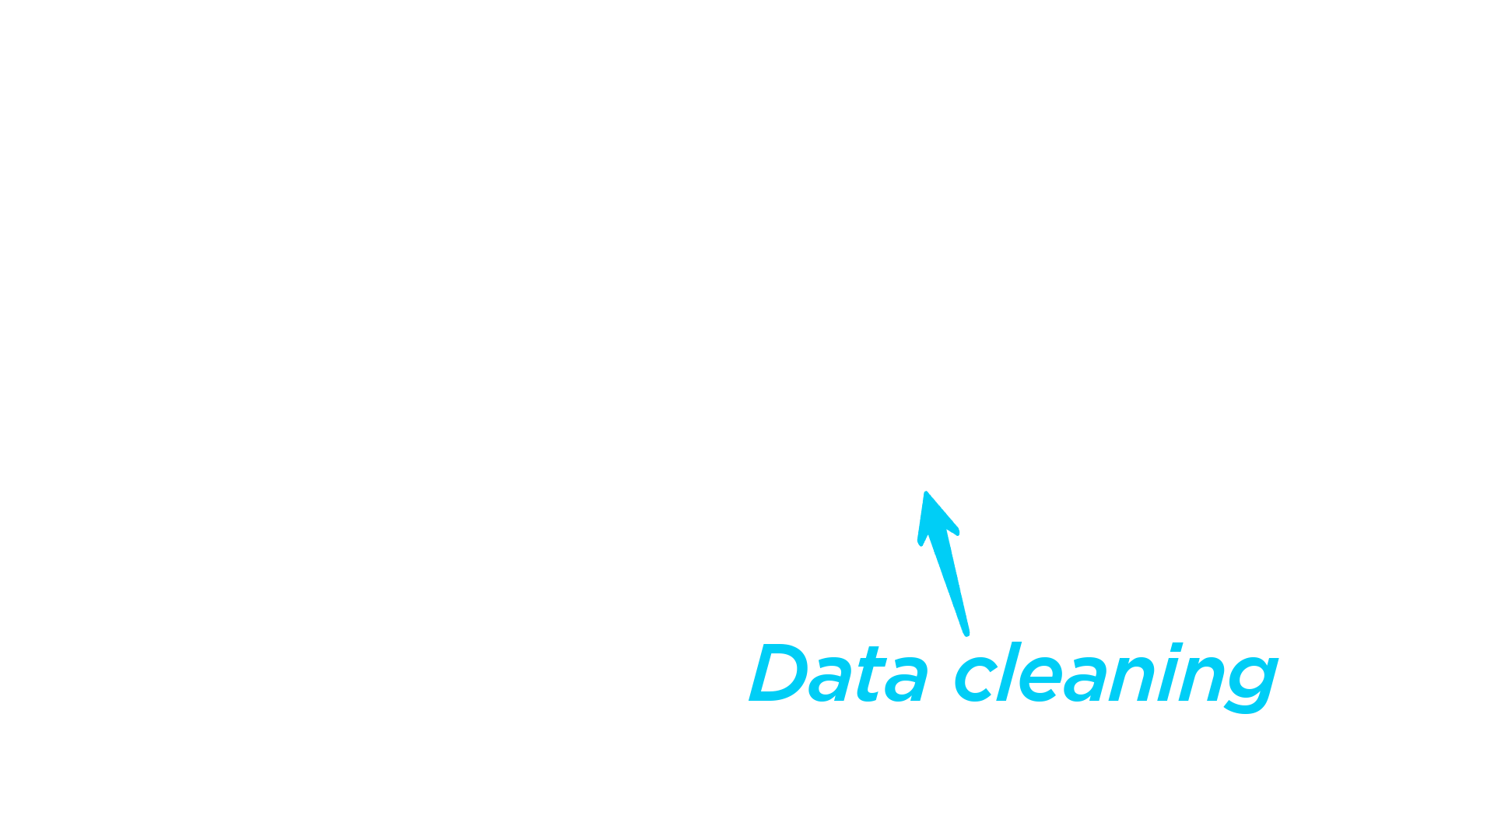
Preprocessing

Slide 12
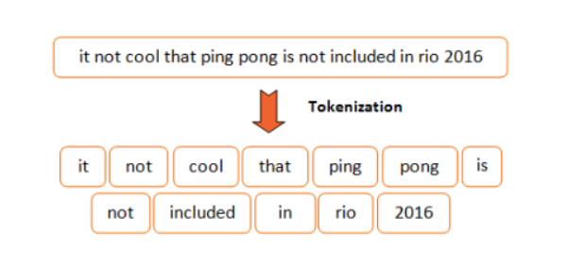
TOKENIZATION

Slide 13

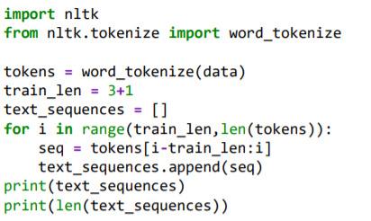
TOKENIZATION
['The', 'Project', 'Gutenberg', 'eBook'],
['Project', 'Gutenberg', 'eBook', 'of']
['Gutenberg', 'eBook', 'of', 'The']

Slide 14
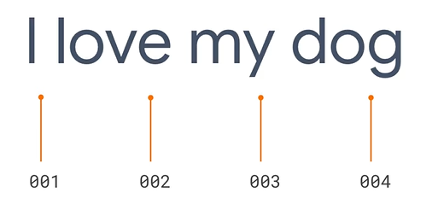
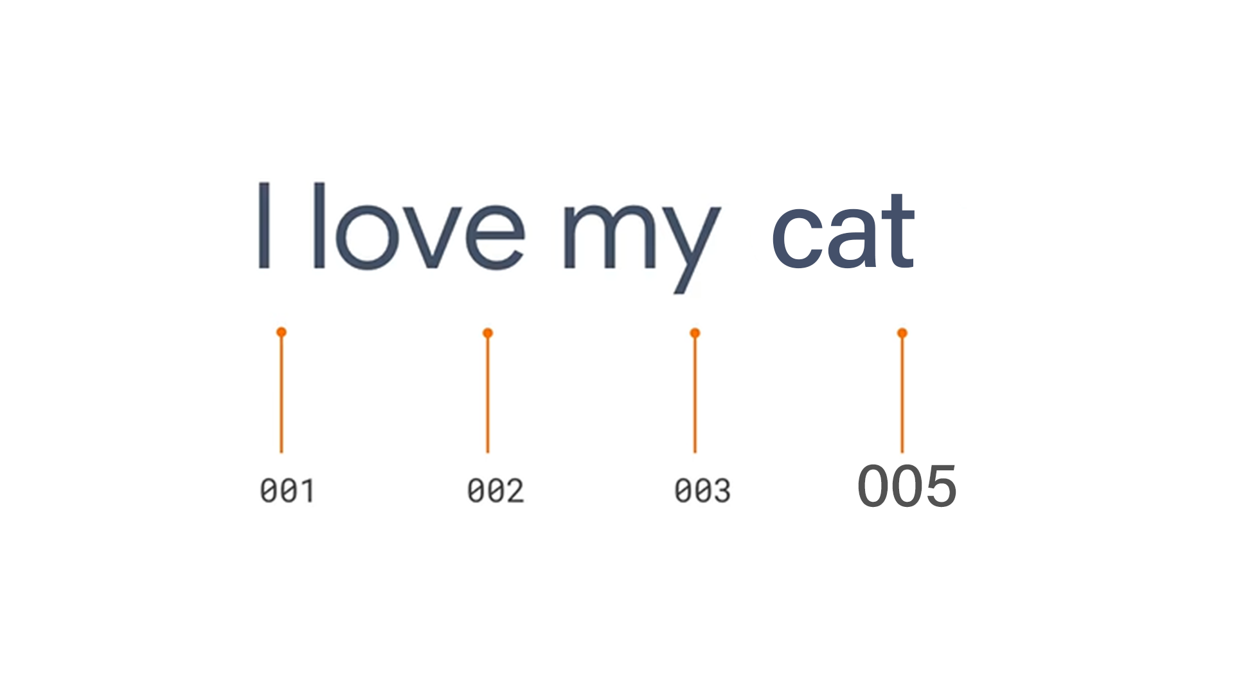
TOKENIZATION

Slide 15
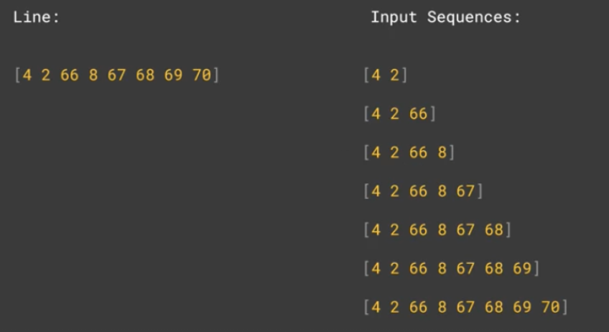
PAD SEQUENCES

Slide 16
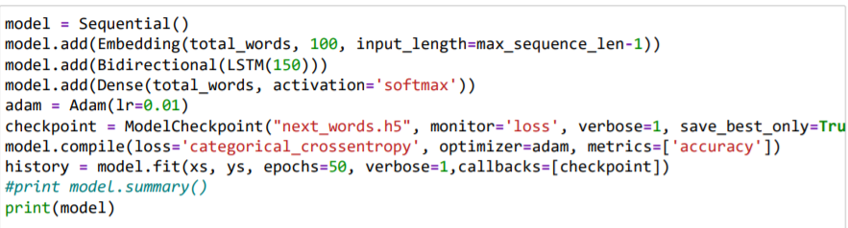
Training part

Slide 17
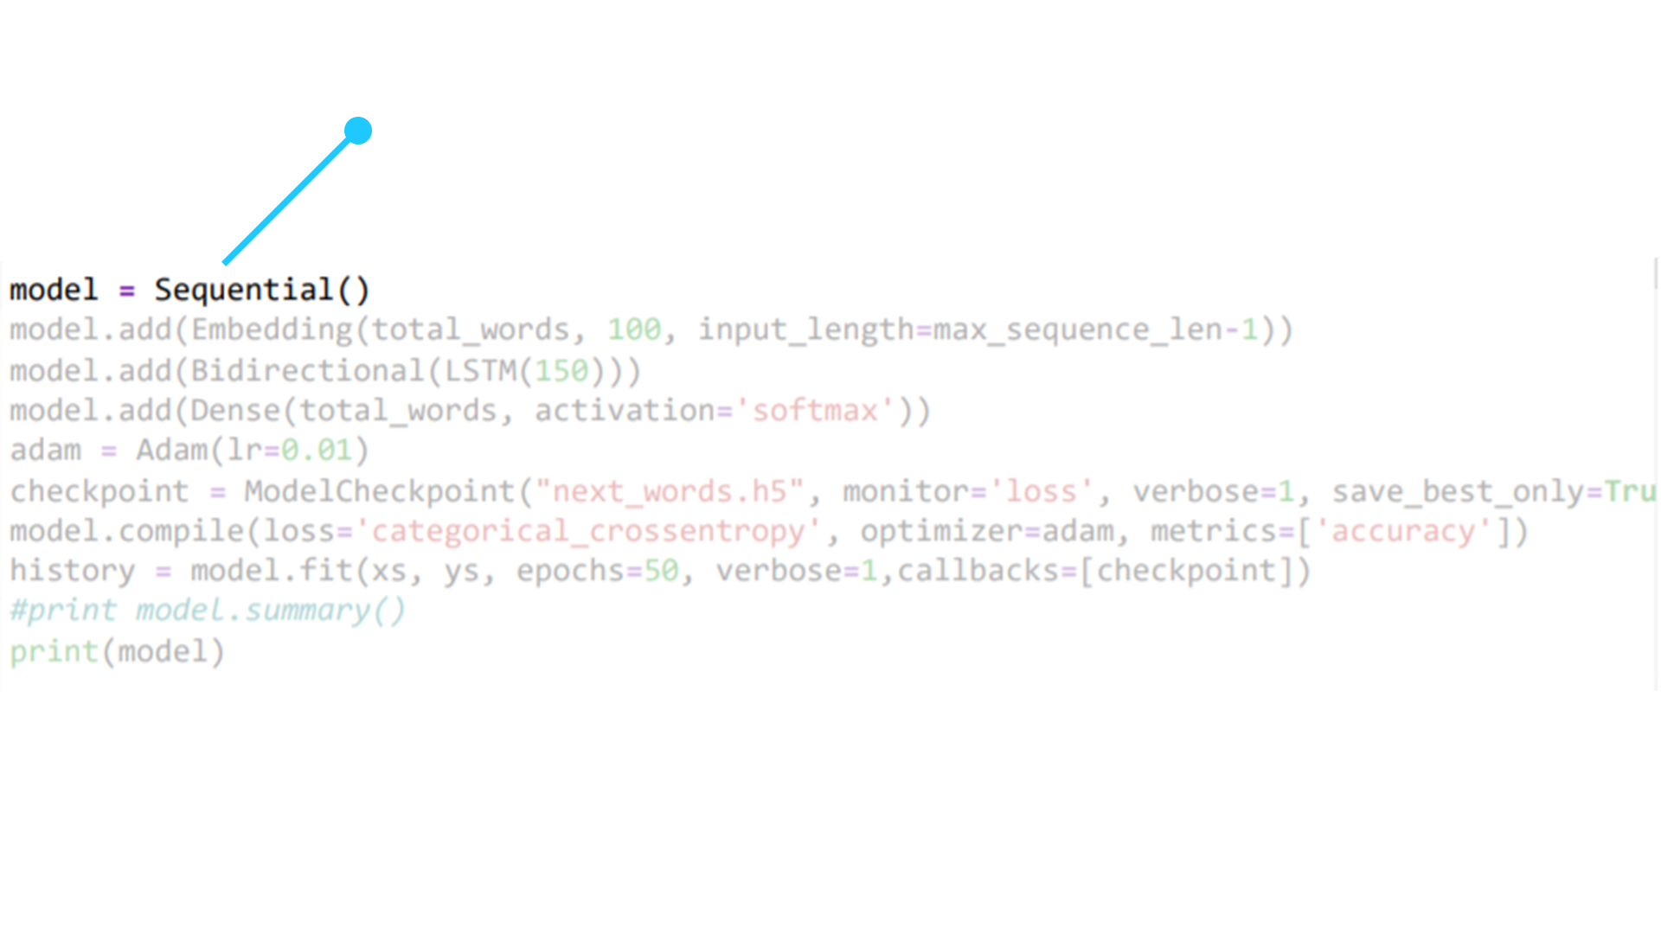
The sequential API allows you to create models layer-by-layer for most problems. It is limited in that it does not allow you to create models that share layers or have multiple inputs or outputs.

Slide 18
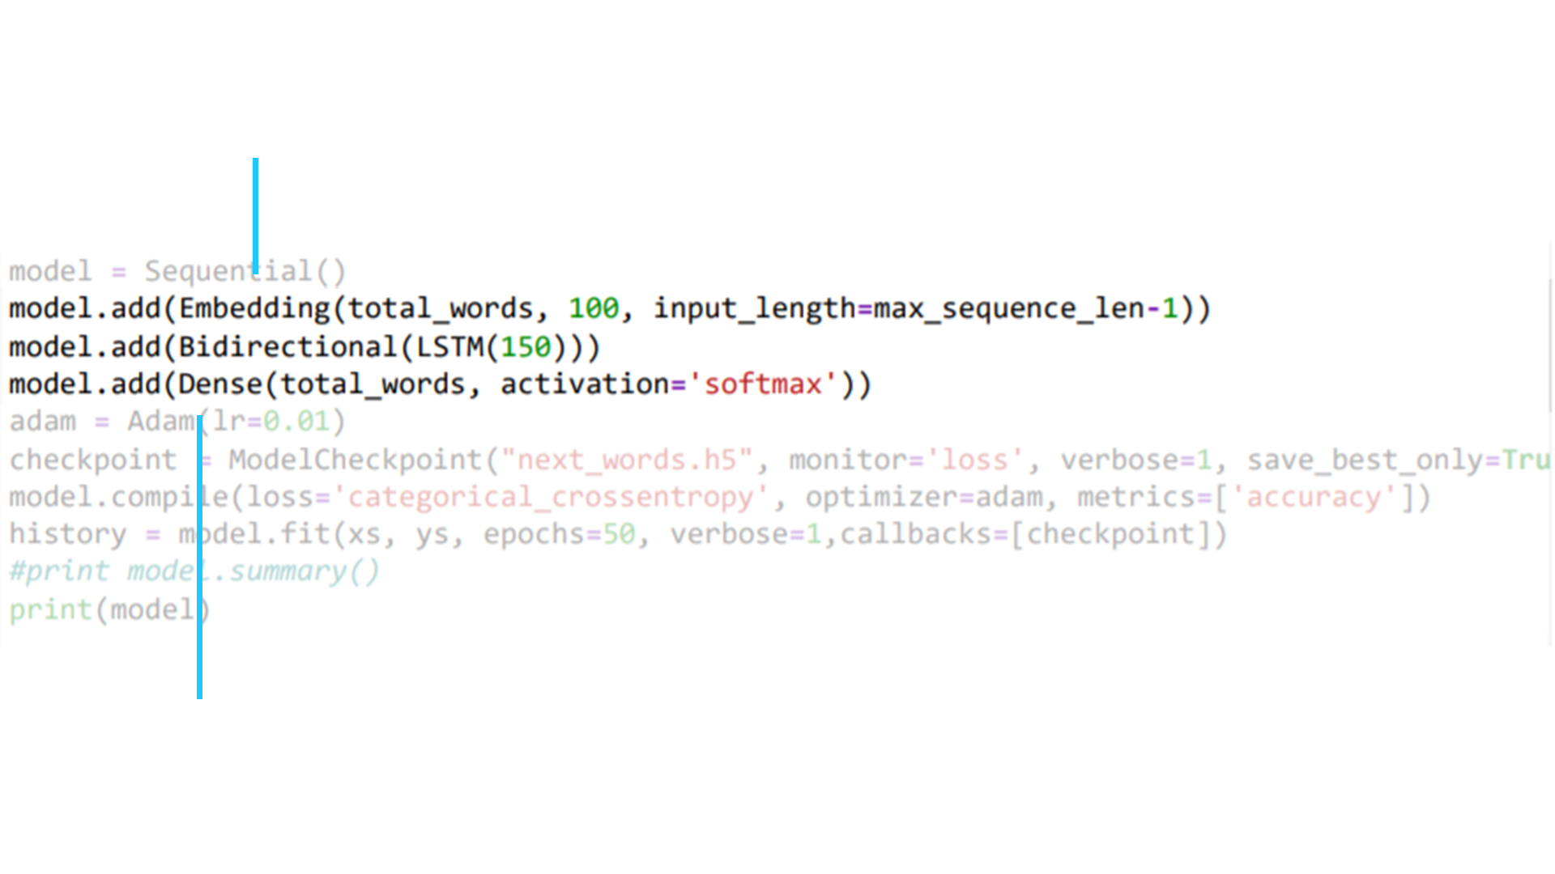
Embedding layer enables us to convert each word into a fixed length vector of defined size.
Dense implements the operation: output = activation(dot(input, kernel) + bias)

Slide 19
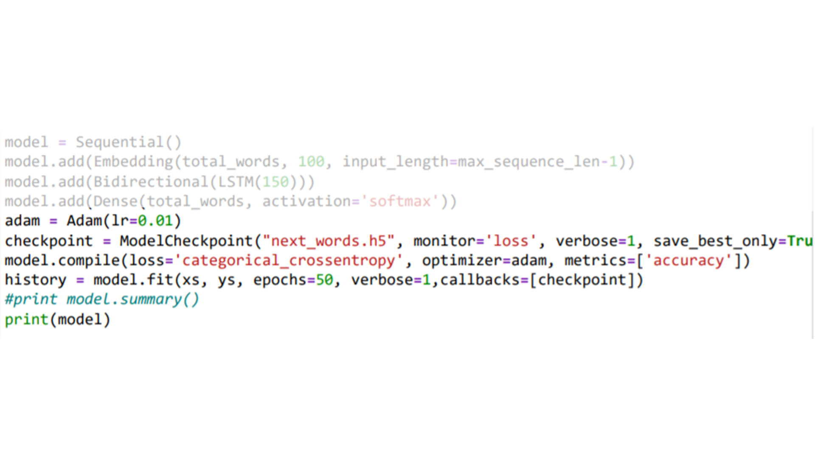
Adaptive Gradient Algorithm that maintains a per-parameter learning rate that improves performance on problems with sparse gradients
Extra box for any info

Slide 20
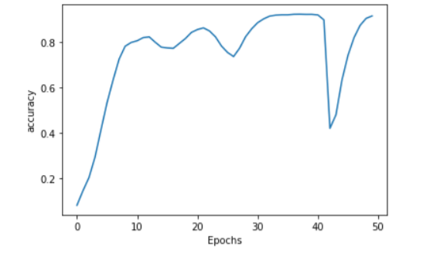
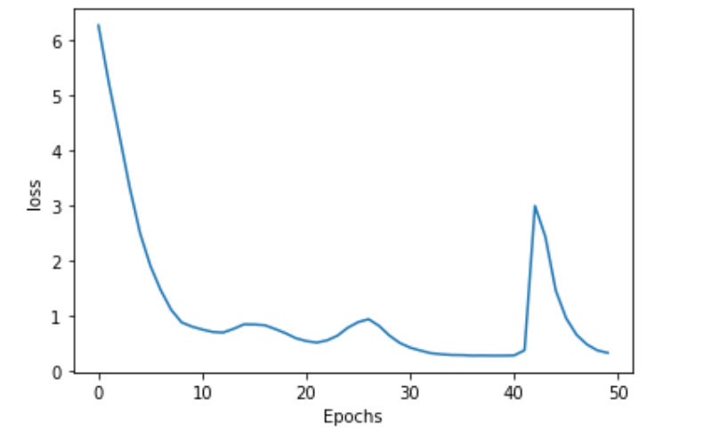
Training part
Accuracy
Loss

Slide 21
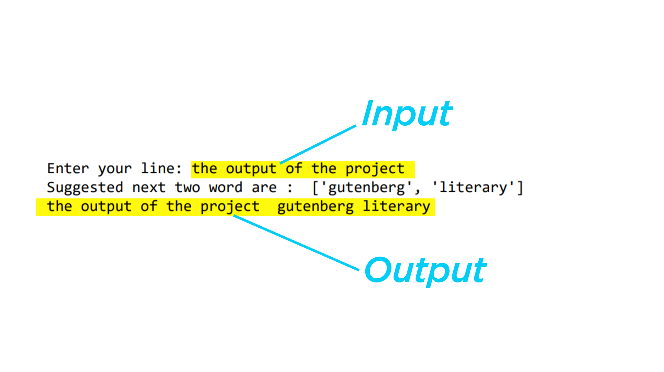
OUTPUT :
Progress till now
Backend :
Frontend :

Slide 22
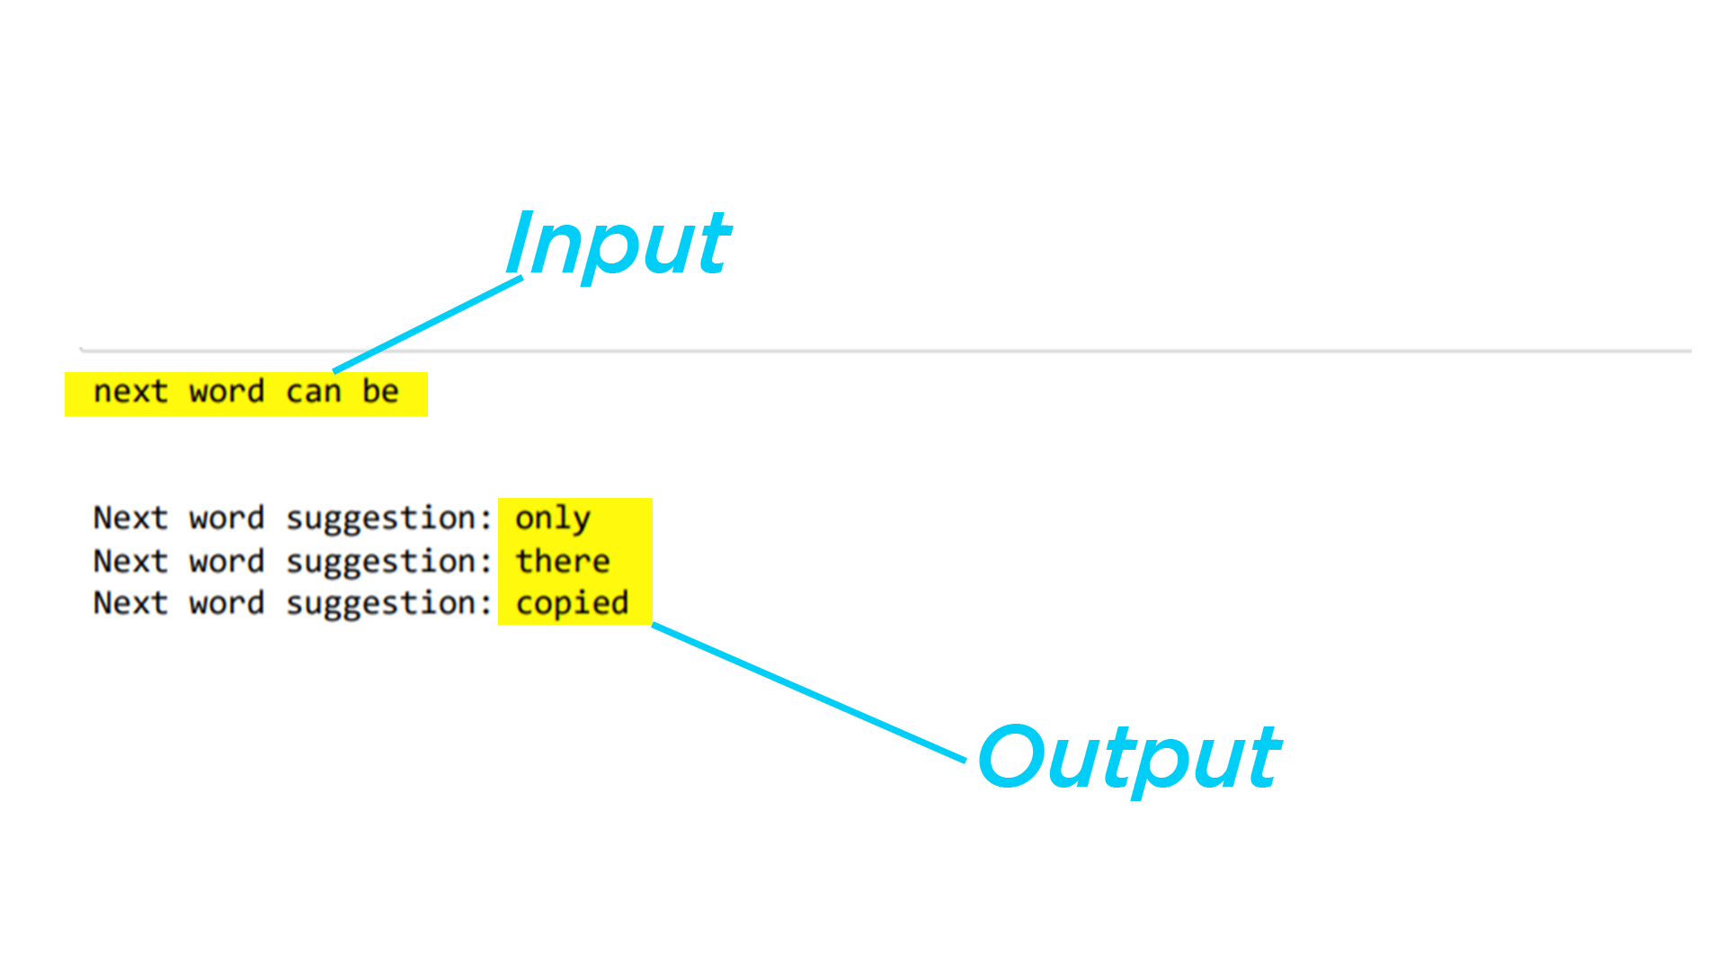
OUTPUT :
Progress till now
Backend :
Frontend :

Slide 23

THE END

